Slide 1



Welcome to
CS 345 Operating Systems
Virtual Memory (19)

Slide 2
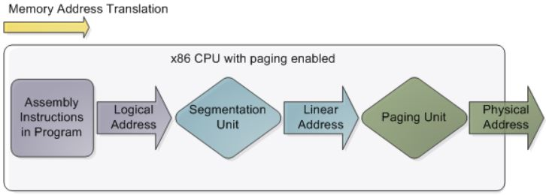
Memory Management Techniques
Fixed Partitioning
Divide memory into equal or unequal fixed size partitions at boot time
Dynamic Partitioning
Create partitions as programs loaded
Simple Paging
Divide memory into equal-size pages, load program into available pages
Simple Segmentation
Divide program into segments according to usage
Virtual-Memory Paging
Paging, but not all pages need to be in memory at one time
Virtual Memory Segmentation
Like simple segmentation, but not all segments need to be in memory at one time

Slide 3

Things To Throw Away
Expired Food. It's time to go through your pantries and the fridge. ...
Saved Wedding Favors. It's time to say farewell to all of those doodads you've picked up at your pals' weddings. ...
CD's. ...
Desk Trinkets. ...
More Bed Linens Than You Need. ...
All Those Promo Tees. ...
Greeting Cards. ...
Old Cell Phones (& other electronics)
Half-Used Notebooks
Past Invitations
Bills From 6 Months Ago
Magazines
Dry-Cleaner Hangers
Dried Up Personal Items
Cable Cords & Wires

Slide 4
Replacement Algorithms
Random (RAND)
choose any page to replace at random
Belady’s Optimal Algorithm
best but unrealizable – used for comparison
First-In, First-Out (FIFO)
for the dogs, forget ‘em
Least Frequently Used (LFU)
strictly a straw-man for stack algorithms
Least Recently Used (LRU)
discard pages we have probably lost interest in
Clock – Not Recently Used (NRU)
efficient software LRU

Slide 5
Belady’s Optimal Algorithm
Belady’s optimal replacement
“Perfect knowledge” of the page reference stream.
Select the page that will not be referenced for the longest time in the future.
Generally unrealizable
Page
0
1
2
3
2
3
2
0
4
3
2
1
2
1
0
1
2
4
2
1
0
1
Frame
Belady's Optimal
0
0
0
0
0
0
0
0
0
4
4
4
1
1
1
1
1
1
1
1
1
1
3
3
3
3
3
3
3
3
3
3
3
0
0
0
4
2
2
2
2
2
2
2
2
2
2
2
2
2
2
2
2
2

Slide 6
FIFO page replacement
Replace oldest page in memory
Fair: All pages receive equal residency
Some pages may always be needed
Difficult to implement (time stamps)
Often improved performance by adding more frames
Page
0
1
2
3
2
3
2
0
4
3
2
1
2
1
0
1
2
4
2
1
0
1
Frame
First in First out
0
0
0
0
3
3
3
3
3
4
4
4
1
1
1
1
1
1
1
1
1
1
1
1
0
0
0
2
2
2
2
2
2
2
2
2
2
2
2
2
2
3
3
3
3
3
0
0

Slide 7
Least Frequently Used (LFU)
Replace page in memory with fewest accesses
Also called Not Frequently Used (NFU).
When the cache is full and requires more room the system will purge the item with the lowest reference frequency.
New items are in danger of being soon replaced.
Page
0
1
2
3
2
3
2
0
4
3
2
1
2
1
0
1
2
4
2
1
0
1
Frame
Least Frequently Used
0
0
0
0
3
3
3
3
3
4
3
3
3
3
3
0
0
1
1
1
1
1
1
1
0
0
0
0
1
1
1
1
1
2
2
2
2
2
2
2
2
2
2
2
2
2
2
2

Slide 8
Least Recently Used
Replace page not used for longest time in past - Use past to predict the future.
With locality, LRU approximates OPT (Belady’s algorithm)
harder to implement, must track which pages have been accessed (time stamp, page stack)
does not handle all workloads well
Updates must occur at every memory access
huge overhead - few computers offer enough hardware support for LRU.
Page
0
1
2
3
2
3
2
0
4
3
2
1
2
1
0
1
2
4
2
1
0
1
Frame
0
0
0
0
3
3
3
3
3
4
4
4
1
1
1
1
1
Least Recently Used
1
1
1
1
1
1
1
0
0
0
2
2
2
2
2
2
2
2
2
2
2
2
2
2
3
3
3
3
3
0
0

Slide 9
Implementing LRU
Can use a reference bit
cleared on loading
set every time the page is referenced
Reference time tracking implemented in software
periodically scan page tables
note which pages referenced and modified
reset the reference/modified bits
Clock algorithm – efficient software LRU
all pages are in a circular list
start scan where the previous scan left off
replace the first un-referenced page you find

Slide 10
Second-Chance Algorithm
Often called “clock algorithm”
keep circular list of all pages (RPT’s, UPT’s, Memory)
clock pointer refers to next page to consider
If the reference bit is 1
clear the reference bit
move clock pointer to the next page
If reference bit is 0 and not pinned
swap page out to disk (if dirty)
move clock pointer to next page
return page number
Could cycle through entire list before finding victim

Slide 11
Clock Algorithm
Clock/3 Frames
Frame
7
0
1
2
0
3
0
4
2
3
0
3
2
1
2
0
0
7
7
7
2
2
2
2
4
4
4
4
3
3
3
3
0
1
0
0
0
0
0
0
0
2
2
2
2
2
1
1
1
2
1
1
1
3
3
3
3
3
0
0
0
0
2
2
Clock/4 Frames
Frame
7
0
1
2
0
3
0
4
2
3
0
3
2
1
2
0
0
7
7
7
7
7
3
3
3
3
3
3
3
3
3
2
2
1
0
0
0
0
0
0
0
0
0
0
0
0
0
0
0
2
1
1
1
1
1
4
4
4
4
4
4
4
4
4
3
2
2
2
2
2
2
2
2
2
2
1
1
1

Slide 12
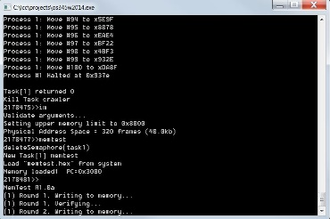
CS 345 Project 4
Virtual Memory

Slide 13
Learning Objectives…
Student explores the concepts of swap space, main memory, and virtual memory.
Understand the details of page faulting and page replacement algorithms, what memory access, hit and fault counts are, and how to track them.
Student implements a virtual address translation system (MMU) to Project 4 using a two-level hierarchical page table system.
An LC-3 processor is provided that makes all memory accesses through one function.
That’s right! You only need to implement one function for Project 4, namely, getMemAdr().

Slide 14
Step 1 – Virtual Memory
1. Validate that the demo LC-3 simulator works for a single task with pass-through addressing (virtual equals physical) for the LC-3 by setting MMU_ENABLE to 0 and executing the commands “crawler” and “memtest”.
#define MMU_ENABLE 0
unsigned short int *getMemAdr(int va, int rwFlg)
{
unsigned short int pa;
// turn off virtual addressing for system RAM
if (va < 0x3000) return &memory[va];
#if MMU_ENABLE
#else
// calculate physical from virtual virtual
pa = va;
#endif
// return physical memory address
return &memory[pa];
} // end getMemAdr

Slide 15
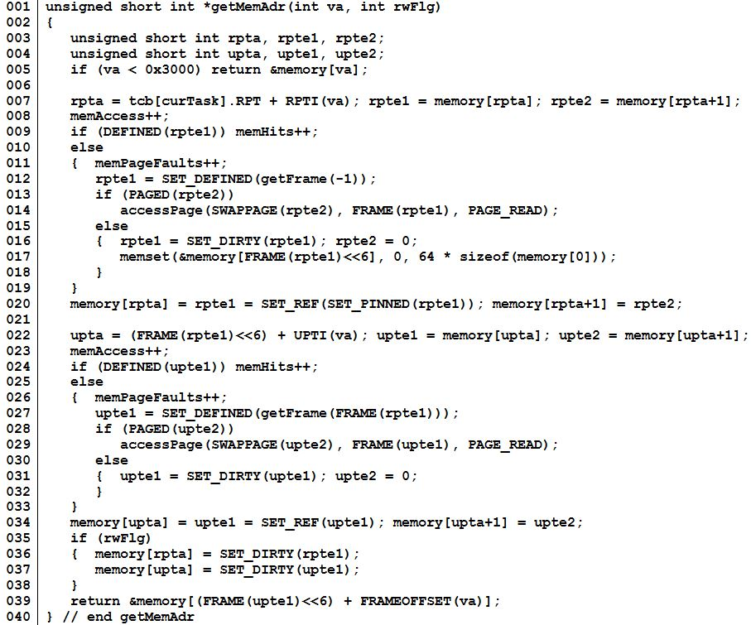
Step 1 – Virtual Memory
Virtual address.
Root Page Table
(1st level)
User Page Table
(2nd level)
Return physical address.

Slide 16
Two-Level Paging System
Virtual Address
15 … 11 10 … 6 5 … 0
RPTE #
UPTE #
Frame Offset
Root Page Table
User Page Table
LC-3 Main Memory
+
Flags / Frame #
Flags / UPT #
+
Frame<<6
Offset
15 … 6 5 … 0
RPT
One per process
Physical Address

Slide 17
Virtual Memory
All tables in LC-3 memory.
All memory accesses thru getMemAdr().
RPT’s pinned.
Each process has an RPT pointer (changed on context switch).
Memory limit set by IM command.
x0000
System
(unmapped)
Virtual Address
x2000
Non-Swappable
Frames
x2400
Bit Frame Table
RPT’s (Pinned)
x3000
UPT Frames
and
Data Frames
Swappable
Frames
Paged
Swap
Space
Memory Limit
(IM command)
Unpopulated
Memory
xFFFF

Slide 18
Page Table Entry
4 bytes
 |  |  |  |  |  | Frame # (0 – 1023)
F | D | R | P | - | - | f | f | f | f | f | f | f | f | f | f
 |  |  |  | Page # (0 – 8191)
S | - | - | p | p | p | p | p | p | p | p | p | p | p | p | p
• Frame valid (1 bit): one if referenced frame is in main memory; zero otherwise.
• Dirty (1 bit): one if referenced frame has been altered; zero otherwise.
• Reference (1 bit): one if frame has been referenced; zero otherwise.
• Pinned (1 bit): one if frame is pinned in memory; zero otherwise.
• Frame number (10 bits): If referenced page is in memory, this value specifies which frame it occupies. (1024 frames × 64 words = 2¹⁰ × 2⁶ = 2¹⁶ bytes = 65536 words.)
• Swap valid (1 bit): one if referenced page has been allocated in swap space; zero otherwise.
• Swap page number (13 bits). This specifies where referenced page is stored in swap space. When you load a page into memory, you should include this value in your frame table summary. (8,192 pages × 128 bytes = 2¹³ × 2⁷ = 2²⁰ bytes = 1,048,576 bytes.)

Slide 19
Global Clock
User Page Table
User Data
Frame
Root Page Table
Swapped UPTs/Data Frames
Swap Space
RPTE’s
UPTE’s
Data Frame’s

Slide 20
Step 2 – Virtual Memory
2. Implement page fault frame replacement using available memory frames only.
Modify createTask() to allocate an unique Root Page Table for each task. (ie, tcb[tid].RPT = LC3_RPT + ((tid) ? ((tid-1)<<6) : 0);)
Fix getMemAdr such that if root page table entry undefined, use getFrame to return a new UPT frame from available memory and initialize all user page table entries.
Fix getMemAdr such that if user page table entry undefined, use getFrame to return a new data frame from available memory.
This should allow you to execute any test program in a full address space.

Slide 21
Step 3 – Virtual Memory
Implement clock page replacement algorithm to unload data frames to swap pages and reload with a new frame or an existing frame from swap space if needed.
Create and validate a “clock” mechanism that accesses all global root page tables, user page tables, and data frames.
Swap to swap space the first frame with the reference bit equal to zero (and not equal to the notme frame).
Advance the clock.
Return frame number for use as a UPT or data frame.
Use the vma function to access a single virtual memory location and then display any non-zero RPT and UPT entries.
This should allow you to execute all the test programs in a 32k word address space (20k of paging frames).

Slide 22
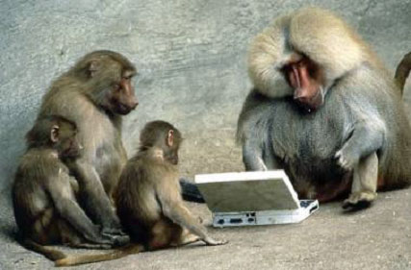

Be Safe

